Slide 2
Kashmir: An issue of security between India and Pakistan (1999-2008)

Slide 3
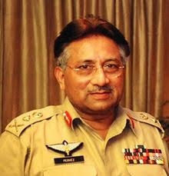

Slide 4
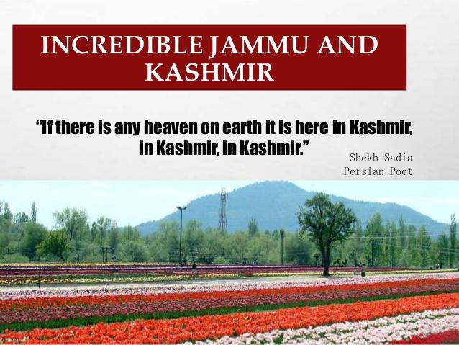

Slide 9
Contents
Introduction
Significance of Kashmir
Indian and Pakistani Perspectives on Kashmir
Research Questions
Research Objective
Findings
Suggestions
Conclusion

Slide 10
Introduction:
New aspects of clashes can be seen between India and Pakistan in 21st century. Pakistan was headed by the military led regime of General Pervez Musharraf whom India deliberated as the controlling brain following the Kargil incident of 1999. India did not legitimate the military government of Pakistan. Meanwhile, India was not inclined to talk with any despot leader of Pakistan. Musharraf sought to reconstruct the flexible and positive status of Pakistan towards all the states of the world particularly India.
This paper would highlight the efforts for the resolution of Kashmir dispute during Musharraf rule in Pakistan.

Slide 11
Significance of Kashmir
Kashmir is geologically, geo-strategically and economically vital for India and Pakistan. On one cross, Kashmir has had a solid tactical and defensive point.
On the other cross, Kashmir has immeasurable farming of timber with head-works of three key rivers of Indus Basin. As well as the status of water is involved, the situation is alarming for Pakistan owing to the flow of river of Indus, Jhelum and Chenab through Kashmir valley before it ran to Pakistan. The farming soil of Pakistan’s major economic producers, Punjab and Sindh Provinces, is watered by these rivers. Pakistan has had anxiety of stopping this water by India.

Slide 12
Indian and Pakistani Perspectives on Kashmir
Pakistan has constantly declares its slogan which claims that the valley of Kashmir must be a part of Pakistan's map as the large number of state's population is Muslim.
At present, Pakistan is controlling nearly about 37% of Kashmir state together with Gilgit, Baltistan (Northern areas) and Azad Kashmir known as Pakistan controlled Kashmir.
On the other hand Indian declarations about Kashmir are doubtful by Pakistan and it presently holds near about 43% of the region Ladakh together with most of the part of Ladakh, Siachen Glacier and the valley of Jammu & Kashmir. It is known as Indian controlled Kashmir or Indian Occupied Kashmir.

Slide 14
Research Questions:
This study would involve the following research questions:
Why the Kashmir conflict is a regional longest dispute?
How has Musharraf tried to resolve the Kashmir dispute?

Slide 15
Research Objective:
The concrete objective of this research is as follows:
To directly address the efforts for the resolution of Kashmir dispute during Musharraf rule in Pakistan.

Slide 16
Findings:
Musharraf Regime (1999-2008) and Indo-Pak relations:
General Musharraf imposed martial law on October 12, 1999 by dismissing the elected government of Prime Minister Nawaz Sharif.
The coup in Pakistan was disliked by India due to two main reasons:
1. India had much confidence on the elected government led by the Nawaz Sharif. Hence, they could not trust a military dictator who has no support in masses.
2. General Pervez Musharraf was involved in Kargil war.

Slide 17
Incident of Indian Plane Hijacking
Indo-Pak relationship became worse due to a plane of India, hijacked in Kandhar after taking off from Katmandu. The Indian authorities stated that hijackers were trained and being supported by ISI. Consequently, India closed all sort of dialogues with Pakistan.
1.1 Agra Conference:
The procedure of reconciliation between both the states was initiated through Agra Conference from 14–16 July 2001.
India planned to discuss the whole sequence of important matters which were acknowledged by both countries in the Lahore Announcement as like political and economic problems, to decrease nuclear threat, CBMs as well as Kashmir issue.
However, all discussions led towards the failure of the Agra Summit.

Slide 18
1.2 9/11 and Change in Pakistan’s Kashmir Policy
The incident of 9/11 proved to be a disaster in relations. In these circumstances, Pakistan withdraw its support for afghan Taliban’s and the Kashmiri freedom fighters, but it was mere an eye wash for the Indian authorities.
Resultantly, Pakistan became international partner in war against terror and facilitated USA and its partners to curb afghan jihads and the Taliban.

Slide 19
1.3 Post 9/11 scenario and Indo-Pakistan Relations:
1.3.1 Terrorism: Opening of a new chapter of conflicts between India and Pakistan
India acquired the chance to relate the Kashmir issue with the act of international extremism.
They asserted that various Pakistani based terrorist groups and organizations are involved in the Cross border terrorism in India.
1.3.2 A new chapter of hostility between Pakistan-India relations
The Indian Parliament was attacked by the group of terrorists on 13th December 2001 in New Delhi.
He assumed that two Pakistan grounded radical groups were openly engaged in the Parliament attack.

Slide 20
1.3.3 Blame Game
The Indian Government accused Pakistan’s ISI for backing the terrorist webs against India.
Moreover, India put charges over the Pakistan centered networks named the Laskar-e-Taiba (LeT) and Jaish-e-Muhammad (JeM) for the rebellion in Kashmir.
1.3.4 Misperceptions and the largest military standoff between both countries (Pakistan and India)
The confusions continued to develop and led to deep-rooted and intensified war in the form of the biggest military standoff between both nations. India instantly installed her militaries (land, air, naval) along the Pakistani borders from May to June 2002.
The skirmish worsened which increased the risk of nuclear struggle between both nations.

Slide 21
1.3.5 The role of International Community
1.3.5.1 Specifically the role of US regarding the implementation of peace process between Pakistan and India
President Bush played an important part to calm the hostilities primarily after terrorists attacked the Indian Parliament. In a telephonic conversation with Indian Prime Minister Vajpayee, he expressed his sympathy towards India. On the other side, he made a telephonic call to the Pakistani President Musharraf to undertake suitable measures to combat the cross border terrorism in India.
On January 12, 2002 Musharraf took a forward step to lessen the international compels and professed ban to the prominent terrorist organizations, among them most prominent were Jaish-e-Mohammad and Lashkar-e-Taiba. He, moreover, pronounced that Pakistan would not permit her land to be used for violence.

Slide 22
1.3.6 The deadlock broke
The standstill ended in the spring of 2003.
While giving a speech in Srinagar during the mid of April 2003, the Prime Minister of India, Vajpayee enhanced the hand of friendship towards Pakistan. India put certain terms for the restoration of dialogue procedure. The main requirement from India was to end the access in Kashmir and cross boundary extremism. Prime Minister of Pakistan, Mir Zafarullah Khan Jamali cherished the standpoint of Indian Prime Minister.

Slide 23
The deadlock over the two-sided relations broke further on 23 November 2003 when the Prime Minister of Pakistan, Mir Zafarullah Khan Jamali made a scheme of one-sided ceasefire along the Line of Control (LOC) in Jammu and Kashmir. The Indian government recognized the cease fire plan that was made by Pakistan and claimed that the ceasefire should be operative to the Real Ground Position Line in Siachin. The ceasefire was ultimately applied on 26 November 2003.

Slide 24
1.4 The Restoration of Composite Dialogue:
In January 2004, the Summit conference of SAARC took place in Islamabad. The Pakistani and Indian leaders met in the Summit conference where they proclaimed the restoration of composite dialogue.
The plan of composite dialogue involve the following eight central concerns:
Confidence building measures (CBM’s)
Jammu and Kashmir
Siachin
Wular Barrage
Sir Creek
Extremism and Drug Smuggling
Financial and Marketable Collaboration
Advancement of friendly interactions in numerous spheres

Slide 25
1.5 Strategy for joint counter-terrorism measures:
Suddenly in July 2006, Pakistan and India relations became verse due to attacks in Mumbai. The Indian police fired the responsibilities of Mumbai attacks on Pakistan based Lashkar-e-Taiba.
In September 2006, a meeting of higher diplomatic authorities was held in Havana and it was jointly decided that a strategy of counter-terrorism will be laid out to eliminate terrorism from the region.
1.6 President Musharraf’s Plan for reduction of state armed forces from Seven Regions
President Musharraf recommended that classification of several regions of the dubious zone requires to be passed out, followed by their demilitarization and a determination of their position. He acknowledged the subsequent seven regions for this intention. Two zones—Azad Kashmir and Northern areas—are under the regulation of Pakistan whereas five zones are under Indian influence.

Slide 26
It was terminated by India as undesirable as it envisioned redrawing of the regional map in J & K.
1.7 Musharraf’s Four point Formula on Kashmir:
On 5th December 2006, President Musharraf projected his four point resolution to the Kashmir issue . This formula involved:
The spineless or spongy boundaries in Kashmir without alteration of boundaries.
Self-sufficiency or self-governance within each constituency of Kashmir
Demilitarization of all constituencies
A combined administrative system

Slide 27
Conclusion:
Musharraf was in a state to influence the Indian leadership. The Indian governance decided to overview Musharraf’s Plans over Kashmir. The Indian Prime Minister soon acknowledged that India and Pakistan should reach to a conclusion to design the solution of the Kashmir conflict. The both governments were in contact through backdoor channels for the implementation of Musharraf’s proposals.
Conversely, with the democratic change of 2008 in Pakistan, the whole situation was changed and the plans made by Musharraf administration were not completely employed by the new democratic régime. Moreover, the reconciliation progression became the prey of Mumbai Attacks or 26/11 happening led to the logjam between both countries.

Slide 28
Suggestions
Violation of human rights must be stopped in Kashmir. Education and employment facilities should be given to Kashmiris. Because it is their fundamental rights. Although, this may not be the ultimate solution, but it may create peaceful environment for settlement.
Because both the disputing states are nuclear powers, therefore, both the nations should minimize the nuclear development process.
Proxy-wars must be banned from both sides. Political leaders of both the states should not use radical and anti-peace elements against each other. These states should reach to a diplomatic agreement by demilitarizing the region of Kashmir.

Slide 29
The old plan of holding referendum in Kashmir is the best possible solution. After referendum, if Kashmir emerge as an independent state, it may act as a buffer state between India and Pakistan in order to hold and maintain good relations. It is also possible that after referendum, the Kashmiri people would decide to interpolate with Pakistan which would not be tolerable for India. Therefore, India is against about any resolution having choice of referendum.

Slide 30
If India does not reach on maintaining referendum for the self determination of Kashmiri people (Pakistan’s stance) and Pakistan does not agree to seized Kashmir as essential portion of India (India’s stance) then the finest choice for the resolution is the proposal of a Chinese intellectual that ‘postpone the conflict’, which means to advance the region, provide confined self-rule, prosperity of public, stress-free interaction and movement between the dual portions of Kashmir, simple permit procedures, easy-going border, person to person communication and harmony in the zone will one time lead to enduring solution of the puzzle. If the opponents of the two world wars with land differences i.e. France and Germany can develop welcoming and joined attitude then why can’t Indo-Pak stabilize their affairs and resolve two- sided clashes.

Slide 31
